Slide 1
Sensitivity Analysis
How to conduct a Sensitivity Analysis on Our Model?
Use Goodness of fit to measure in concrete figures
The higher the Goodness of fit, the more regular the data are and the less sensitive the strategy is.
Predictability of Changes
Relationship proved by Claims and Our Model

Slide 2
Sensitivity Analysis
Case 1: A Longer Stowing Time
To generate the data of discompliance index, we use the sigmoid model. Why?

Slide 3
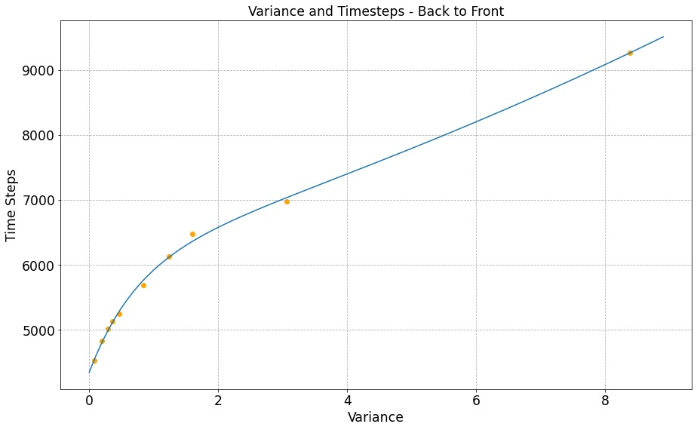
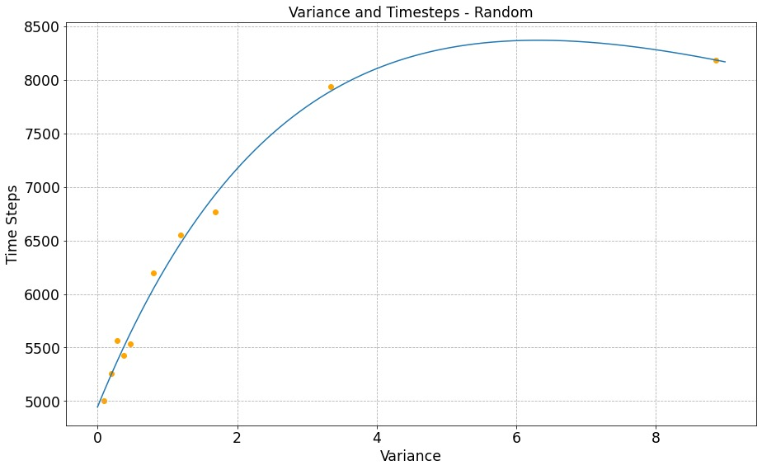
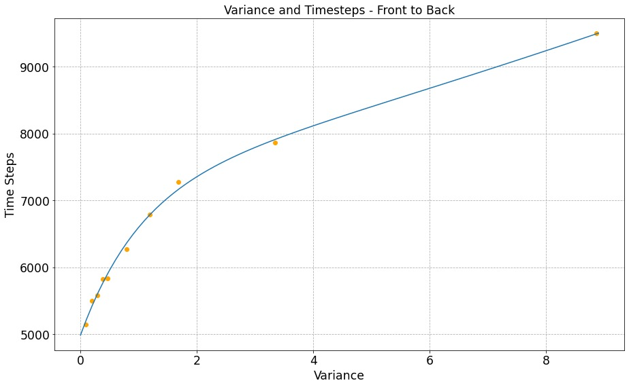
Sensitivity Analysis
Case 1: A Longer Stowing Time
When considering the comparison on longer stowing time and variance, we define Stable functions as those with Linear graphs. Both the functions of Front to Back and Back to Front are upper convex followed by linear, while Random without obvious patterns. Thus Random boarding is the most sensitive, as it’s the only Unstable graph.
Fig. Comparison on Longer Stowing Time, Variance

Slide 4
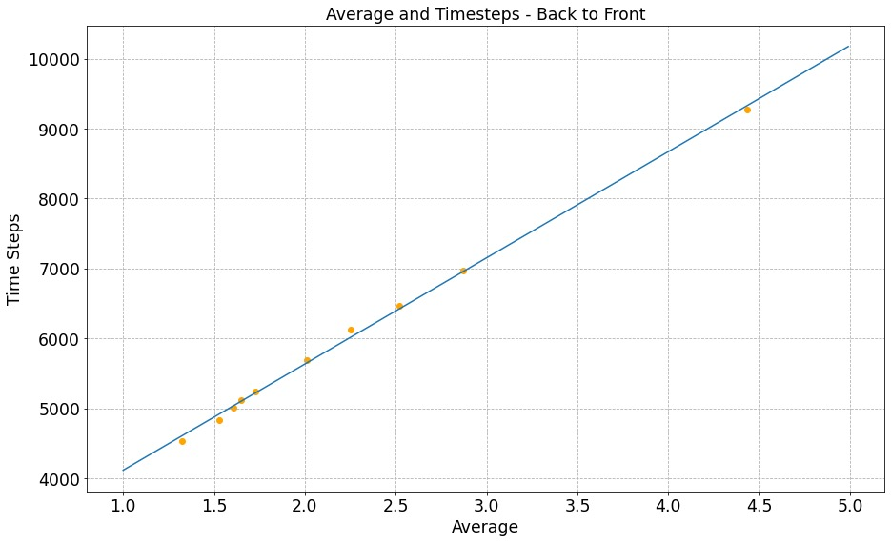
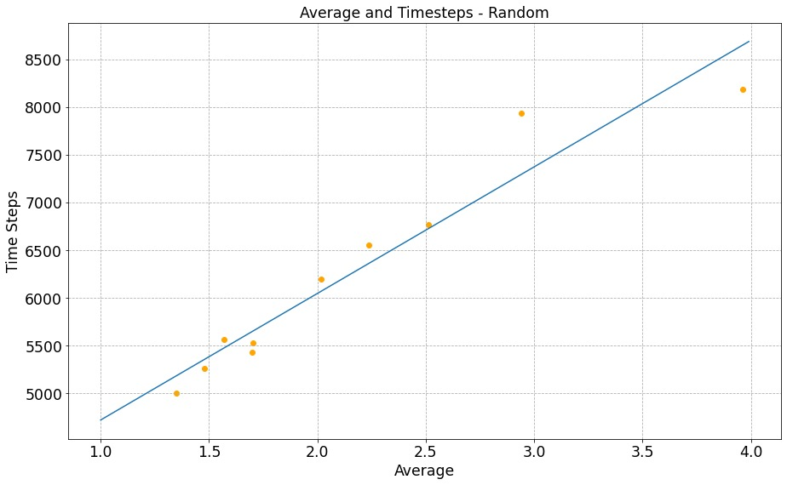
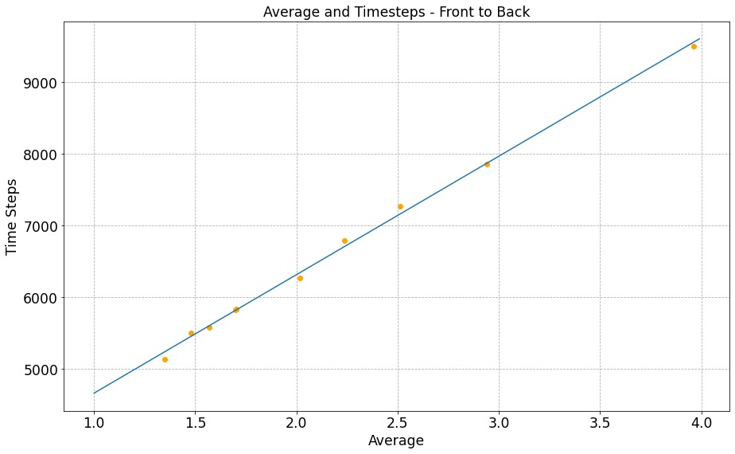
Sensitivity Analysis
Case 1: A Longer Stowing Time
Random boarding is the most sensitive while Front-to-Back method seems totally not sensitive, as the points on the second graph (random) are farther from the line than that of the other two graphs and thus the goodness of fit is lower.
Fig. Comparison on Longer Stowing Time, Overall Time

Slide 5
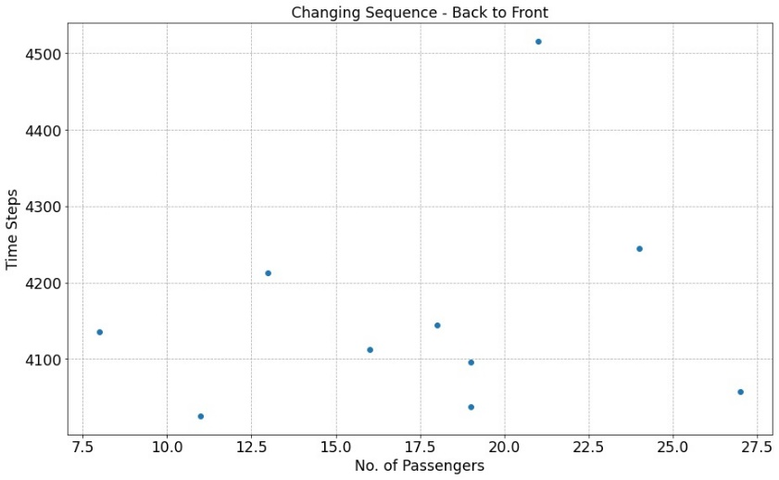
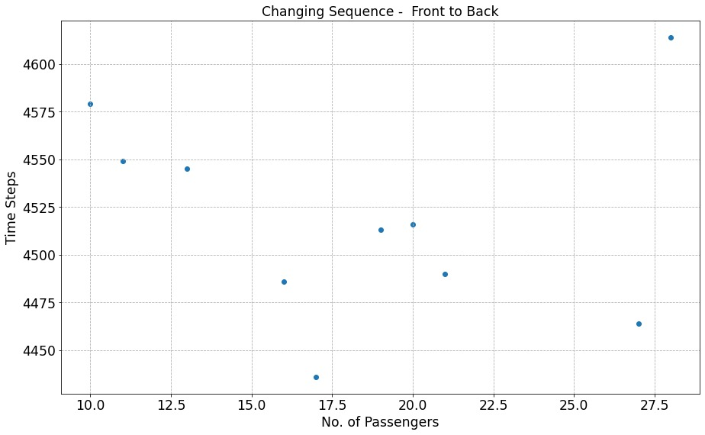
Sensitivity Analysis
Case 2: Queue Jumping
Both Methods are Sensitive which makes a Big Impact on Total Results, as shown on the graph, the points are irregularly distributed.
Fig. Comparison on Queue Jumping

Slide 6
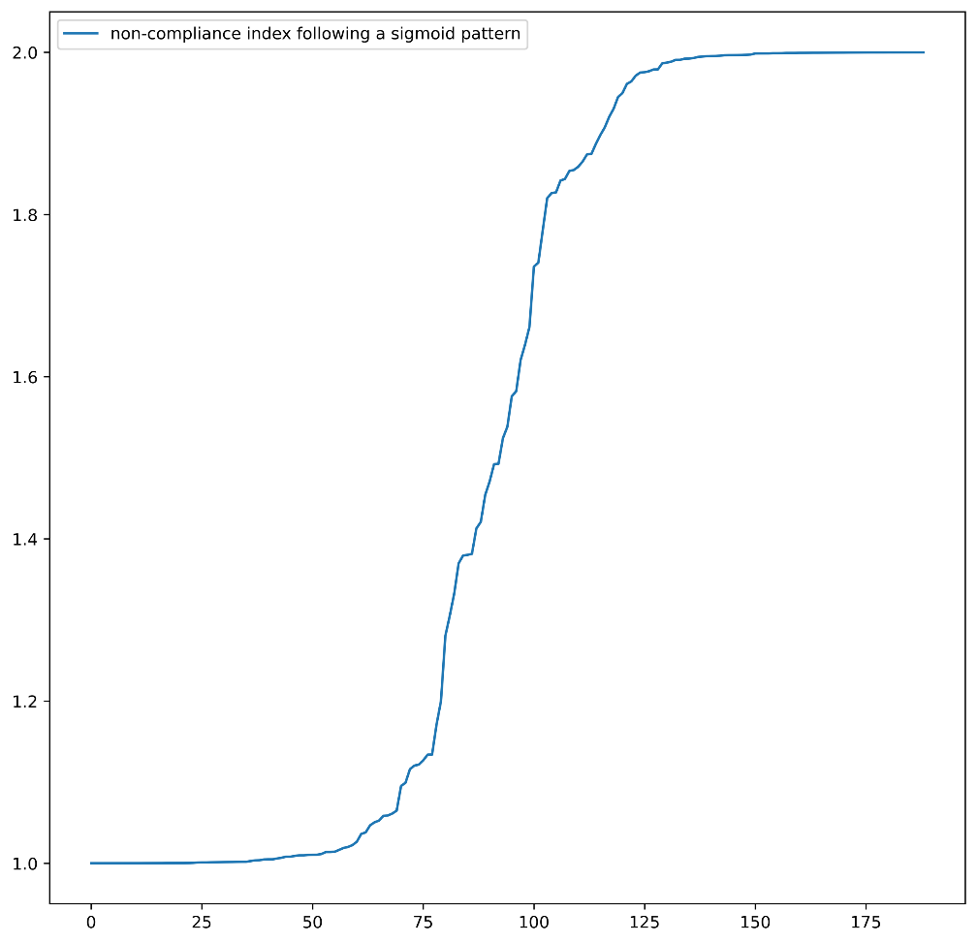

Sensitivity Analysis
We use Sigmoid Model for Random Distribution $σ\left(x\right)=−\frac{1}{1+e^{−x}}→σ^{′}(x)$
Commonly Used in Statistics
Usage determined by nature of function: $ℝ→$A Custom Range,
reaching the limit at both ends with linear in the middle
Fig. Sigmoid Model Demonstration

